Slide 1
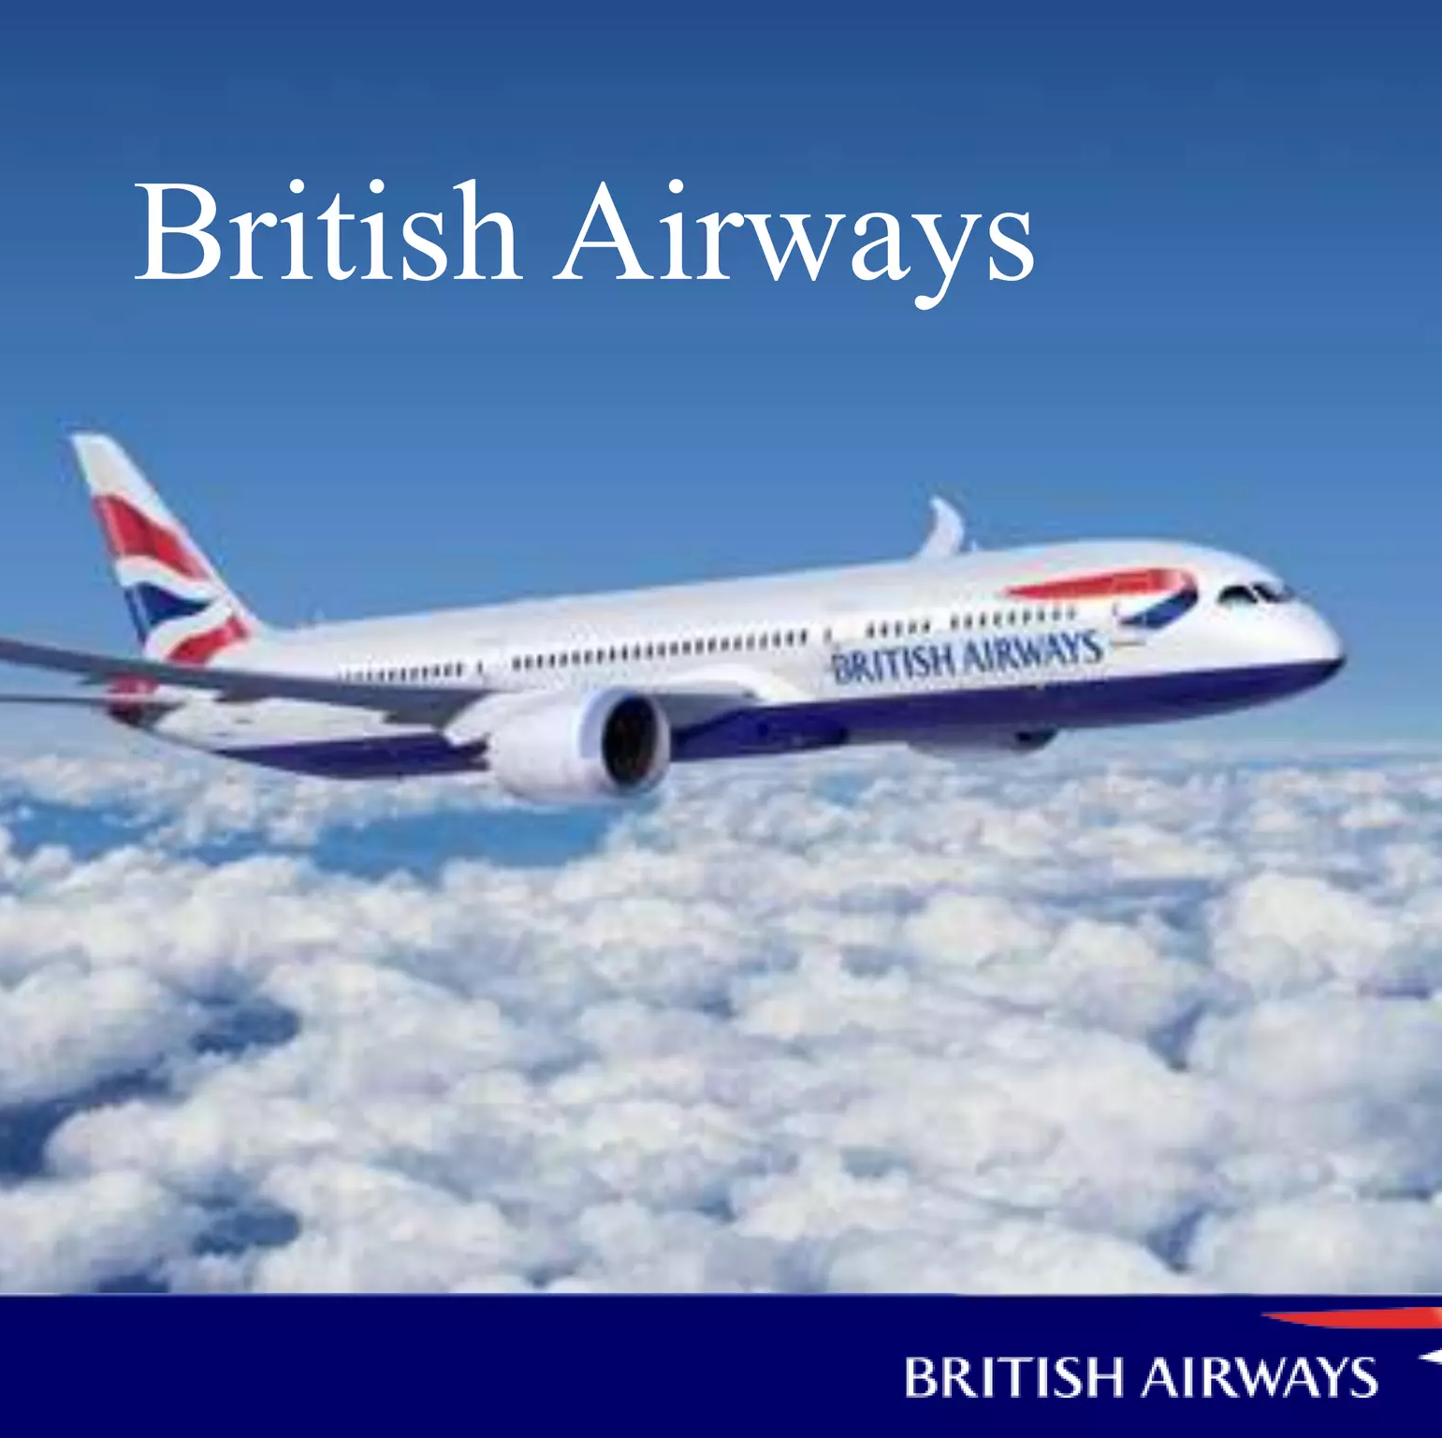
British Airways Virtual Internship (Data Science)
Analysing the Customer Behaviour based on their reviews

Slide 2
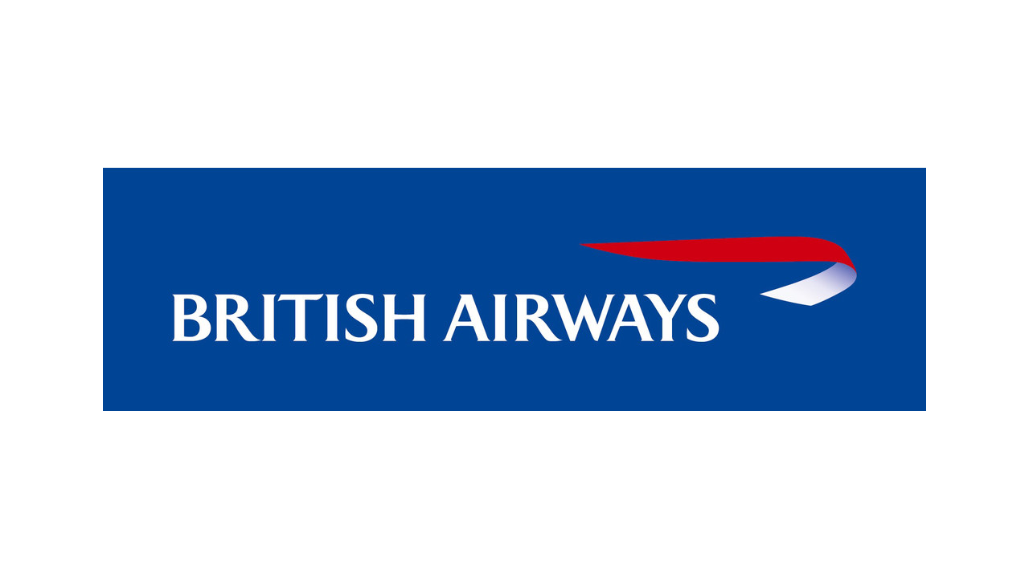
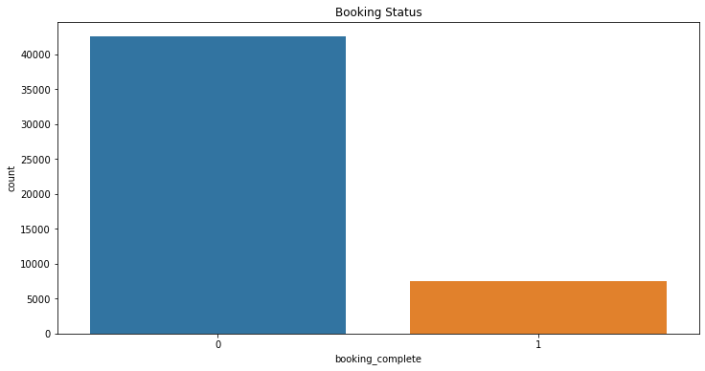
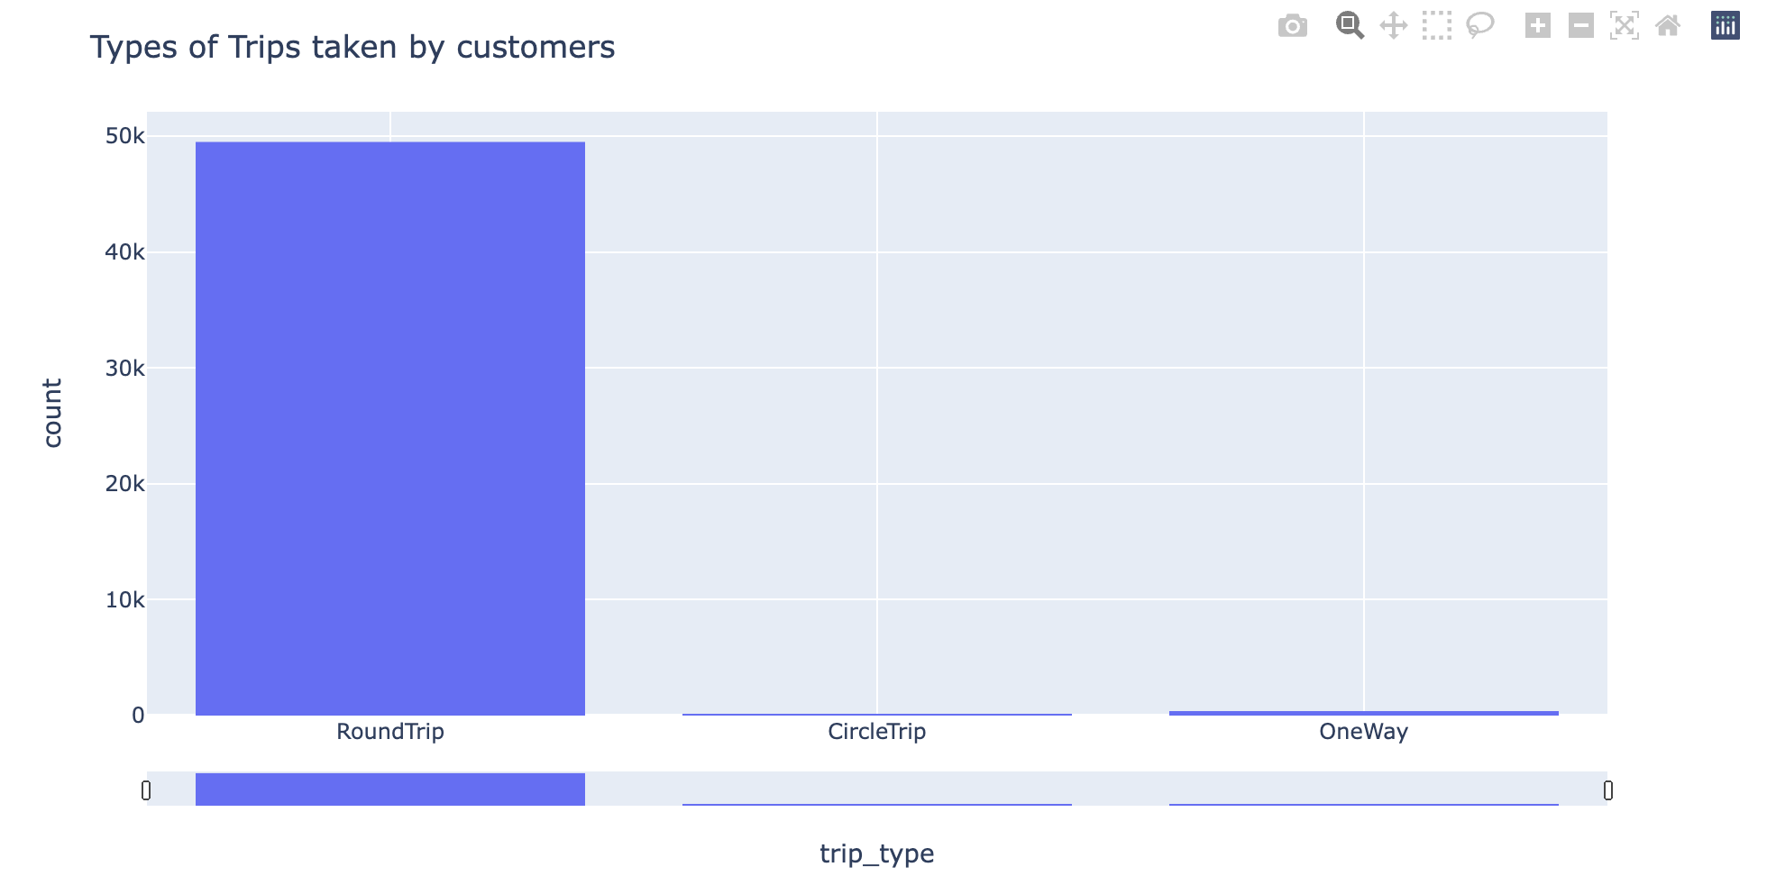
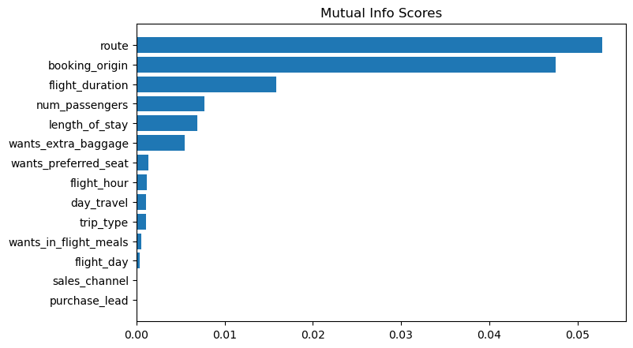
Customer Buying Behavior Prediction
Booking Status (Number of People who have completed the booking and people who have not completed the booking
Types of Trips Taken by Customers from British Airways
1. Round Trip 2. Circle Trip 3. One way
Top Features that are dependent on booking_complete feature
Top Features that are dependent on booking_complete feature:
1. Route 2. booking_origin 3. flight_duration 4. wants_extra_baggage 5. length_of_stay

